Slide 1
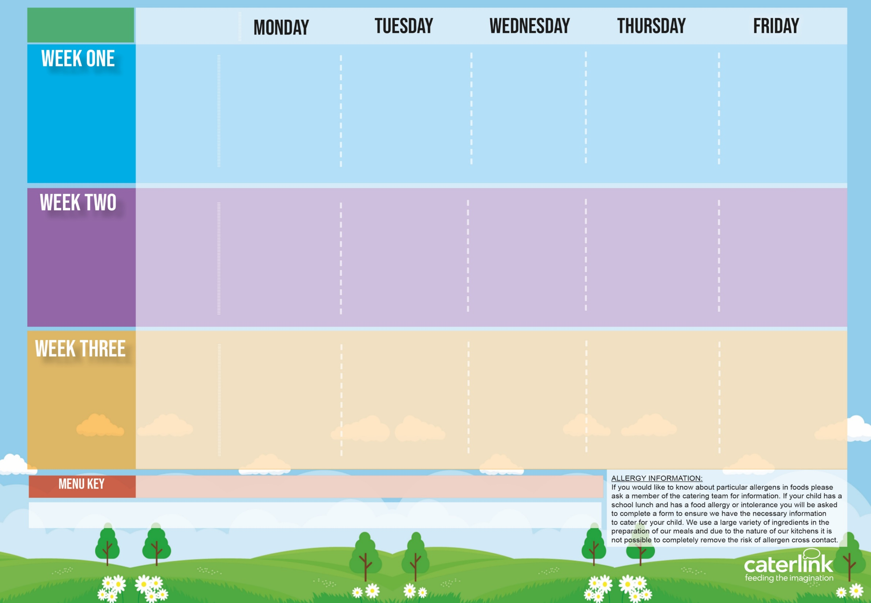
Spring Summer
2025
Option One
Option Two
Vegetables
Dessert
Macaroni Cheese | BBQ Chicken Pizza with Salads | Roast Chicken Sausage, Mash & Gravy | Spaghetti Bolognaise | Fishfingers with Chips & Tomato Sauce
Tomato and Lentil Pasta | Cheese & Tomato Pizza With Salads | Tomato Pasta | Vegan Spaghetti Bolognaise | Cheese & Bean Pasty with Chips & Tomato Sauce
Vegetables of the Day | Vegetables of the Day | Vegetables of the Day | Vegetables of the Day | Vegetables of the Day
Apple Flapjack | Summer Lemon Cake | Fruit Platter | Strawberry Jelly with Mandarins | Ice Cream
21/04/2025
12/05/2025
09/06/2025
30/06/2025
21/07/2025
15/09/2025
06/10/2025
Option One
Option Two
Vegetables
Dessert
Lentil and Sweet Potato Curry with Rice | Pork Hot Dog with Wedges & Tomato Sauce | Roast Chicken, Stuffing, Roast Potatoes, & Gravy | Chefs Special Chicken and Chickpea Korma with Rice | Battered Fish with Chips & Tomato Sauce
Mild Mexican Chilli With Rice | Vegan Hot Dog with Wedges & Tomato Sauce | Tomato Pasta | Chickpea Curry And Rice | Cheese and Tomato Quiche with Chips
Vegetables of the Day | Vegetables of the Day | Vegetables of the Day | Vegetables of the Day | Vegetables of the Day
Iced Vanilla Sponge | NEW Strawberry and Apple Crumble with Custard | Freshly Chopped Fruit Salad | Vanilla Shortbread | Peaches and Ice Cream
28/04/2025
19/05/2025
16/06/2025
07/07/2025
01/09/2025
22/09/2025
13/10/2025
Option One
Option Two
Vegetables
Dessert
Beef Burger with Potato Wedges | NEW Green Thai Chicken Curry with Rice | Roast Chicken, Stuffing, Roast Potatoes & Gravy | NEW Greek Macaroni Pastitsio with Greek Salad and Tzatziki | Fish Fingers and Chips
Smokey Bean Burger with Potato Wedges | NEW Chefs Special Five Bean Jollof Rice | Tomato Pasta | Cheese and Tomato Pinwheel | All Day Vegetarian Breakfast
Vegetables of the Day | Vegetables of the Day | Vegetables of the Day | Vegetables of the Day | Vegetables of the Day
Pear & Cocoa Upside Down Cake | Cheese and Crackers | Fruit Medley | Oaty Cookie | Ice Cream
05/05/2025
02/06/2025
23/06/2025
14/07/2025
08/09/2025
29/09/2025
20/10/2025
Added Plant Protein
Wholemeal
Vegan
Chef’s Special
Available Daily: - Freshly cooked jacket potatoes with a choice of fillings - Bread freshly baked on site daily- Daily salad selection – Fresh Fruit and Yoghurt

Slide 2
Spring Summer
2025
Option One
Option Two
Vegetables
Dessert
 | C91 BBQ Chicken Pizza with SD92 SB8 SD126 Salads | P3 C6 Chicken Sausage, & Mash SD118 Gravy | SD8 Spaghetti B48 Bolognaise | F6 Fishfingers SD5 Chips & SD14 Tomato Sauce
V160 Tomato and Lentil Pasta Sauce | V231 Cheese and Tomato Pizza with SD92 SB8 SD126 Salads | Tomato Pasta | Vegan spaghetti Bolognaise | V191 Cheese & Bean Pasty With SD5 Chips & SD14 Tomato Sauce
Vegetables of the Day | Vegetables of the Day | Vegetables of the Day | Vegetables of the Day | Vegetables of the Day
D171 Apple Flapjack | D168 Summer Lemon Cake | D225 Fruit Platter | D235 Strawberry Jelly with Mandarins | Ice Cream
21/04/2025
12/05/2025
09/06/2025
30/06/2025
21/07/2025
15/09/2025
06/10/2025
Option One
Option Two
Vegetables
Dessert
V108 Lentil and Sweet Potato Curry with SD84 Rice | P3 C6 SD187 Pork Hot Dog with SD6 Wedges & SD14 Tomato Sauce | C4 C5 T1 B4 P5 Roast Chicken SD40 Stuffing, SD82 Roast Potatoes, & SD118 Gravy | NEW C111 Chef Special Chicken and Chickpea Korma with SD84 Rice | F3 Battered Fish with SD5 Chips & SD14 Tomato Sauce
V309 Mild Mexican Chilli With SD84 Rice | V244 SD187 Vegan Hot Dog with SD6 Wedges & SD14 Tomato Sauce | Tomato Pasta | SD8 Spaghetti and V237 V225 Meatballs | V113 Cheese and Tomato Quiche with SD5 Chips
Vegetables of the Day | Vegetables of the Day | Vegetables of the Day | Vegetables of the Day | Vegetables of the Day
D177 Iced Vanilla Sponge | NEW D259 Strawberry and Apple Crumble with Custard | D223 Freshly Chopped Fruit Salad | Vanilla Shortbread | D166 Peaches and D13 Ice Cream
28/04/2025
19/05/2025
16/06/2025
07/07/2025
01/09/2025
22/09/2025
13/10/2025
Option One
Option Two
Vegetables
Dessert
Beef Burger with SD6 Potato Wedges | NEW C114 Green Thai Chicken Curry with SD84 Rice | Roast Chicken, SD40 Stuffing, SD82 Roast Potatoes & SD118 Gravy | NEW GR6 Greek Macaroni Pastitsio with GR4 Greek Salad and GR3 Tzatziki | Fish Fingers and SD5 Chips
V323 SD17 Bean Burger with SD6 Potato Wedges | NEW V322 Chefs Special Five Bean Jollof Rice | Tomato Pasta | Cheese & Tomato Pinwheel | V249 All Day Vegetarian Breakfast
Vegetables of the Day | Vegetables of the Day | Vegetables of the Day | Vegetables of the Day | Vegetables of the Day
D207 Pear & Cocoa Upside Down Cake | D56 Cheese and Crackers | D224 Fruit Medley | D85 Oaty Cookie | Ice Cream
05/05/2025
02/06/2025
23/06/2025
14/07/2025
08/09/2025
29/09/2025
20/10/2025

